Slide 1
DX BALL RE-MASTERED

Slide 2
Project Type: Game Developing
Group Members : Lamia Nazrin
ID: 16-01-04-103
Mehedi Hasan
ID: 16-01-04-102
Somiya Rahman Mojumder
ID: 16-01-04-088

Slide 3
CONTENT
DX BALL HISTORY
DX BALL FEATURES
DEMO IMAGE
HOW TO PLAY
DIFFICULTIES
SCORING POINTS

Slide 4
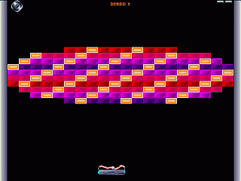
DX BALL HISTORY :
The first DX ball by Michael P. Welch in 1996
DX-Ball is a freeware computer game for the PC first released in 1996 by Michael P. Welch and Seumas McNally. The game, originally based on an earlier series of Amiga games known as MegaBall, is patterned after classic ball-and-paddle arcade games such as Breakout and Arkanoid. A level editor was also made available as well.

Slide 5
DX Ball Re-Mastered Features :
Game Name : DX Ball Re-Mastered
Game Type : Arcade Game
Player Mode : Single Player
Description : The main theme of the game is to break bricks by a bouncing ball from a paddle , that is at the bottom, hitting the bricks on the top of the screen without having the ball fallen down from the paddle . The ball can move in 6 ways. The paddle can move in 2 ways and everything will be handled by the mouse.

Slide 6
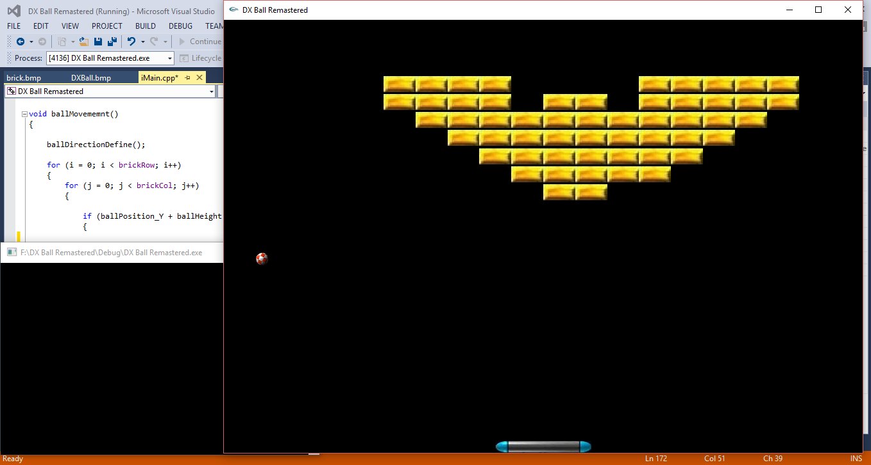
Demo image :

Slide 7
HOW TO PLAY :
To play this game , one will have to to break all the bricks with a ball . And when one will be able to break all the bricks , he/she can proceed to the next level.
The game will have three levels.
While playing , if the ball falls down from the paddle , the game will be over . And to continue the player will be given three chances.

Slide 8
difficulties :
There will 3 levels to end the game .
By the increasing of levels , the game will get harder.
First level will be a beginner level .
In second level one will have to break more bricks.
And there will be time limitations in 3rd level.

Slide 9
Scoring points :
Player will get 5 points for breaking each brick.
After completing whole game player will get bonus score.

Slide 10

GAME OVER

